Slide 1

TECHNOLOGY
CASES
UPDATE
VIRTUAL MEDICINE A CLINIC DAY WITH DR KADER 2020

Slide 2
Relationships with commercial interests:
Grants/Research support NOVONORDISK; SANOFI;
Speaker’s bureau/honoraria:DEXCOM; ANIMAS; MEDTRONIC; ELI LILLY NOVORDISK; BI ; SANOFI; ABBOTT;MERCK; ASTRAZENECA
Consulting/Advisory Board:SAME AS ABOVE
Other/Patents
Presenter Disclosure

Slide 3
HOW MANY PATIENTS A WEEK DO YOU SEE TYPE 1 DIABETES OR TYPE 2 DIABETES
A) 0 TO 5
B) 5 TO 10
C) 10 TO 15
D) OVER 15

Slide 4
IS VIRTUAL MEDICINE HERE TO STAY
YES
NO

Slide 5
TOOLS FOR VIRTUAL MEDICINE
DO YOU USE PLATFORMS FOR YOUR DIABETES PATIENT; SO YOU CAN SEE THEIR DATA
A) YES
B) NO

Slide 6
HAVE YOU HEARD OF
DEXCOM CLARITY
A) YES
B) NO
LIBREVIEW
A) YES
B) NO

Slide 7
WOULD YOU BE INTERESTED IN LEARNING MORE ABOUT THESE PLATFORMS
A) YES
B) NO TAKES TOO MUCH TIME
C) TEACH ME ABOUT IT AND MAYBE WOULD INCORPORATE IT

Slide 8

TECHNOLOGY AND DIABETES
This Photo by Unknown Author is licensed under CC BY-NC

Slide 9
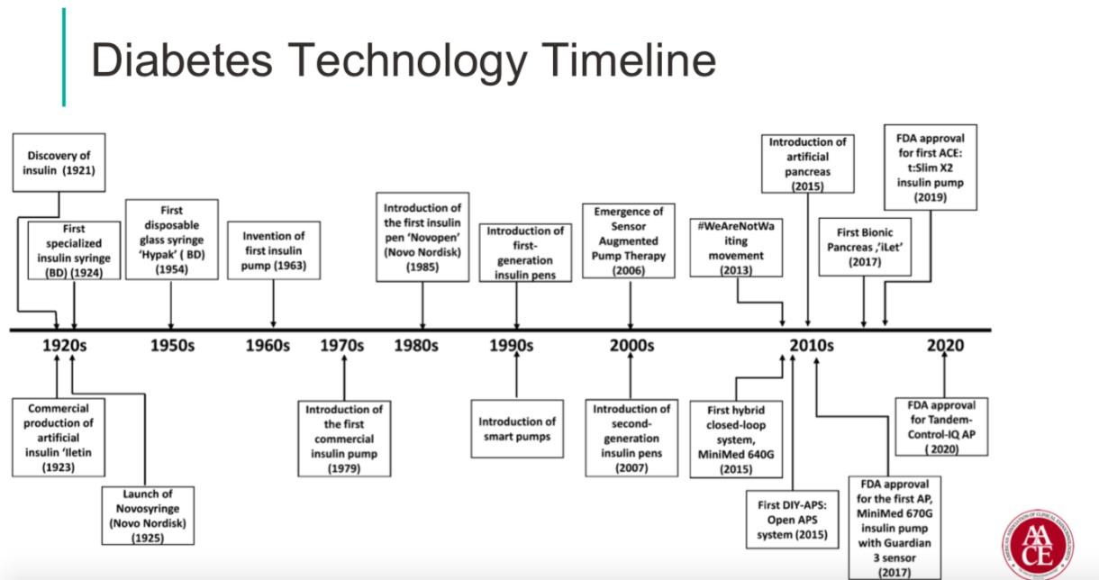

Slide 10

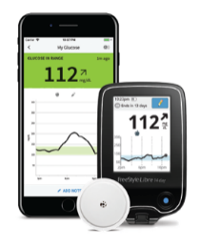

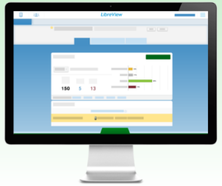
The FreeStyle Libre system and LibreView support telemedicine, enabling HCPs to effectively monitor multiple people with diabetes under their care
For people with diabetes, the FreeStyle Libre system:
Is convenient, easy to use and removes the need for routine finger-prick* testing
Helps understand impact of medication, food, and activity on their glucose patterns
Empowers self management of glucose patterns
*Finger pricks are required if glucose readings do not match symptoms or expectations
For clinicians, LibreView is a user-friendly dashboard that:
Provides access to standardised reports containing comprehensive glucose information needed inform disease management
Allows real-time analysis of data from multiple people with diabetes under their care
Provides a platform for care team collaboration
Sensor-based glucose monitoring using the FreeStyle Libre system offers a complete glycemic picture to help patients and clinicians make more informed diabetes management decisions, across both primary and secondary care^{1,2}
HCP = healthcare professional
1. Kudva YC et al. 2018. “Approach to Using Trend Arrows in the FreeStyle Libre Flash Glucose Monitoring Systems in Adults.” Journal of the Endocrine Society 2 (12): 1320–37. https://doi.org/10.1210/js.2018-00294; 2. Unger J et al. 2020. “Practical guidance for using the FreeStyle Libre flash continuous glucose monitoring in primary care.” Postgraduate Medicine, 1–9. Advance online publication. https://doi.org/10.1080/00325481.2020.1744393

Slide 11
CHALLENGES OF MANAGEMENT DIABETES
EXPECTATIONS for patients
UNDERSTANDING FLASH MONITORING VERSUS FINGERSTICK
UNDERSTANDING THAT NO 2 DAYS ARE THE SAME AND THAT SUGARS LIKE LIFE CHANGES FROM DAY TO DAY
FRUSTRATIONS ON BOTH MD AND PATIENT SIDE
MY MOTO; MY PATIENTS LIVE THE LIFE AND THE DOCTORS GETS TO SEE MANY DIFFERENT EXAMPLES; WE WORK TOGETHER AS A TEAM

Slide 12
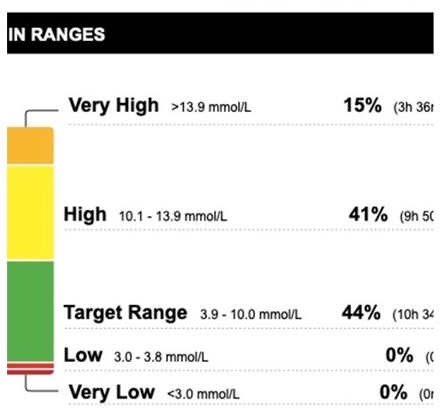
Dr Kader’s perspective
Dr Kader’s clinical experience on telemedicine
TELEMEDICINE:
Since march 2020
is our new reality
Libre view has been a game changer AND
DEXCOM FOR TYPE 1 AND SOME TYPE 2
Our patients can upload from home environment and can connect with us at any time
At appointment we go over time in range

Slide 13

Patient education
What impacts glucose levels
This Photo by Unknown Author is licensed under CC BY

Slide 14

How does food change your glucose?
Carbohydrates have the biggest impact on your readings
^{Follow a healthy eating plan}

Slide 15


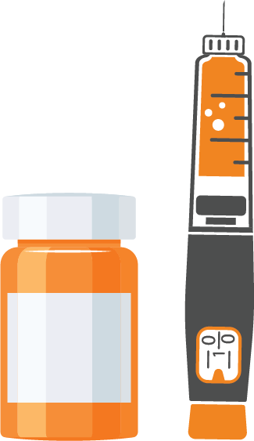



What changes your glucose readings?
Food
Activities
Medication
Illness
Stress
Alcohol

Slide 16
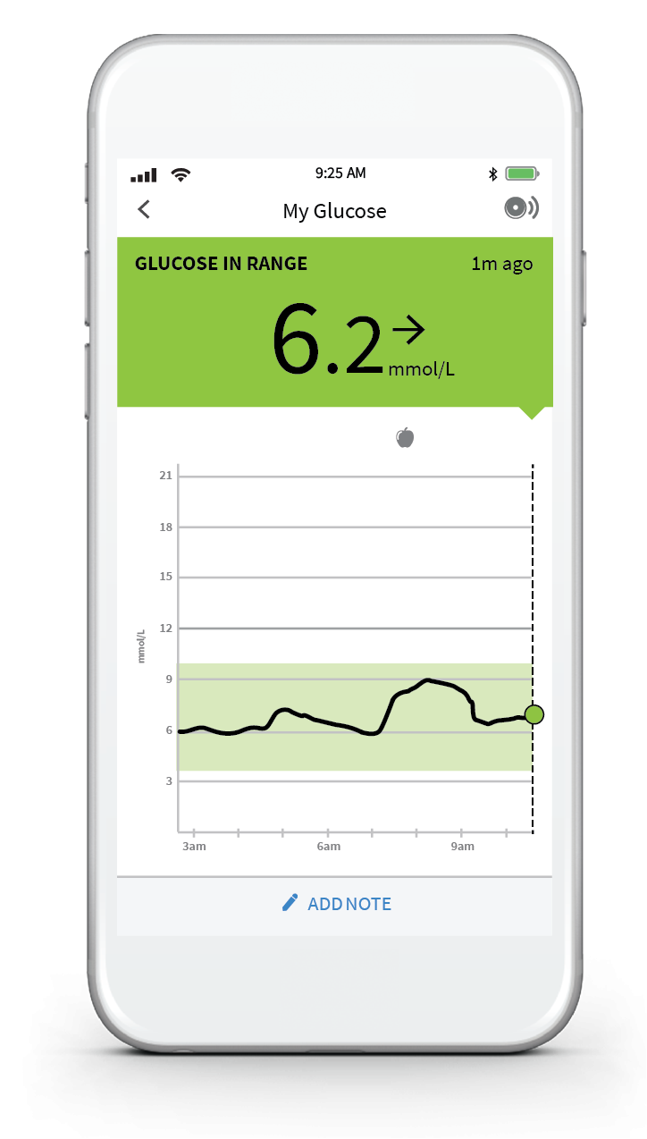
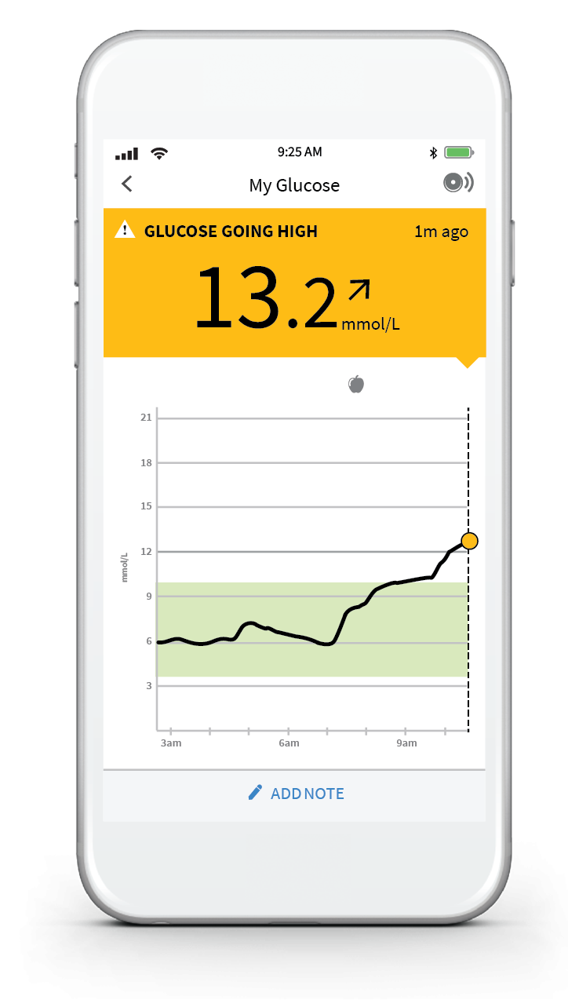
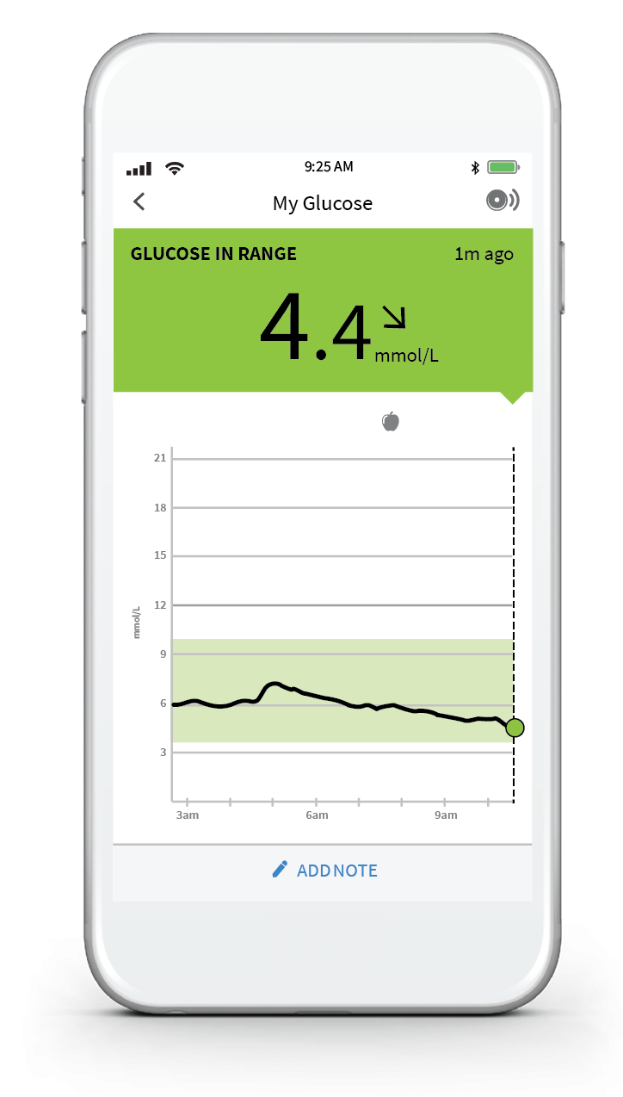



Let’s take a look at how different breakfast foods can change your glucose
NORMAL BREAKFAST
MORE CARBOHYDRATES
FEWER CARBOHYDRATES

Slide 17





Exercise can change your glucose too!
NORMAL
EXERCISE
MORE
EXERCISE
LESS
EXERCISE

Slide 18
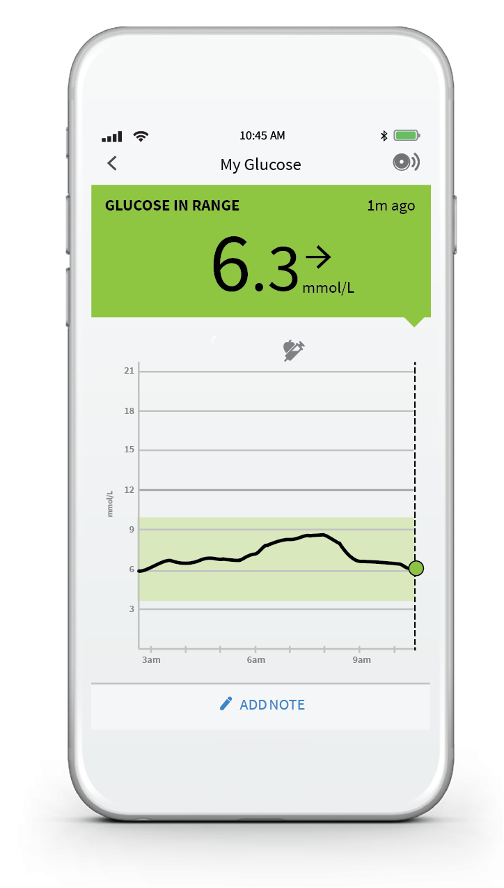
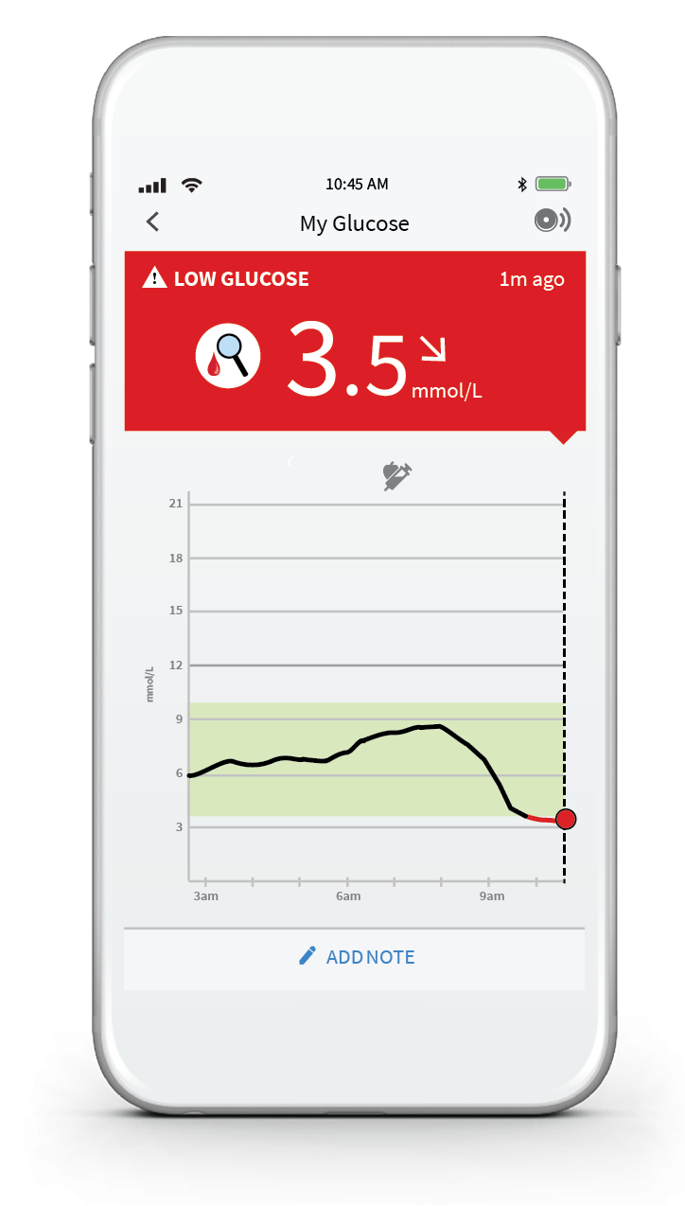

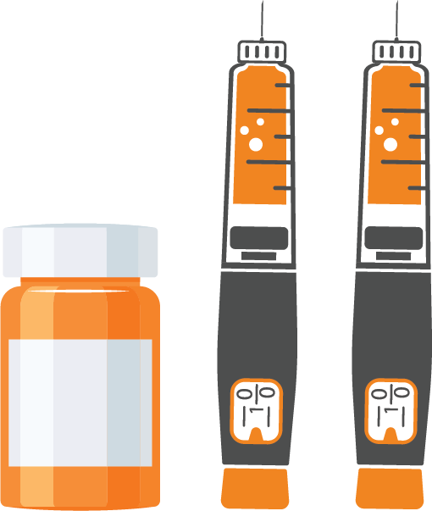

Taking your medication as prescribed can change your glucose
NORMAL MEDICATION
MORE MEDICATION
LESS
MEDICATION

Slide 19

BE AWARE OF CHANGING GUIDELINES
This Photo by Unknown Author is licensed under CC BY-SA

Slide 20
Figure 1: At diagnosis of type 2 diabetes
Assess glycemic control, cardiovascular and renal status*, recent dietary patterns and weight change
Select individualized A1C target (see Chapter 8, 2018 CPG)
Provide and/or refer for diabetes education (see Chapter 7, 2018 CPG)
Start healthy behaviour interventions (see Chapters 10,11,17, 2018 CPG)
Lifestyle changes expected to reduce blood glucose levels
No pharmacotherapy
Start Metformin
(If A1c>1.5% above target, Start metformin + a second agents
Symptomatic hyperglycemia and/or metabolic decompensation
Start insulin ** + metformin
GOAL
Attain A1c target by 3 months
If A1c NOT at target at 3 months
Start Metformin
Adjust or advance therapy
Reassess A1c in 3-6 months (see chapter 9, 2018 CPG)
Got to figure 2
Got to figure 3
In individuals with atherosclerotic cardiovascular disease, history of heart failure (with reduced ejection fraction) or chronic kidney disease, agents with cardiorenal benefits (Figures 2A and 2B) may be considered (see Pharmacologic Glycemic Management of Type 2 Diabetes in Adults: 2020 Update - The User's Guide).
* Unintentional weight loss should prompt consideration of other diagnoses (e.g. type 1 diabetes or pancreatic disease).
** Reassess need for ongoing insulin therapy once type of diabetes is established and response to health behavior interventions is assessed
A 1 C, glycated hemoglobin; CPG, clinical practice guidelines
Lipscombe et al. Can J Diabetes 44 (2020) 575-591
Senior et al., Can J Diabetes. 2020 Oct;44(7):592-596.

Slide 21
Figure 2A. Reviewing, adjusting or advancing therapy in type 2 diabetes.
Regular Review
Assess glycemic control, cardiovascular and renal status
Screen for complications (eyes, feet, kidneys)
Review efficacy, side effects, safety and ability to take current medications
Reinforce and support healthy behaviour interventions
If A1c NOT at target at 3 months
And/or
Change in clinical status
Adjust or advance therapy*
ASCVD, CKD or HF OR Age >60 with 2 CV risk factors⁺
A1C above target and glucose lowering required
ADD or SUBSTITUTE AHA with demonstrated cardiorenal benefits (See Figure 2B)
ADD or SUBSTITUTE AHA⁺⁺ according to clinical priorities⁺⁺⁺
start insulin for symptomatic hyperglycemia and/or metabolic decompensation (Figure 3)
 |  | Established Cardiovascular or Renal Disease |  |  |  |  | Risk Factors
 |  | ASCVD |  | CKD |  | HF | >60 yrs with CV risk factors⁺
Lower risks observed in clinical trials | MACE | GLP1-RA or SGLT2i* |  | SGLT2i* or GLP1RA |  |  | GLP1-RA
 | HHF | SGLT2i* |  | SGLT2i* |  | SGLT2i* (and lower CV mortality) | SGLT2i*
 | Progression of nephropathy | SGLT2i* |  | SGLT2i* |  |  | SGLT2i*
Highest levels of evidence |  |  | Grade A |  | Grabe B | Grade C or D
*Initiate only if eGFR>30 ml/min/1 .73m2
PROVEN cardiorenal benefit in high risk populations** | CV safety, but NO proven cardiorenal benefit** | RISK of HF
GLP1RA dulaglutide, liraglutide, semaglutide | GLP1RA exenatide ER, lixisenatide
SGLT2i canagliflozin, dapagliflozin, empagliflozin | ertugliflozin*** (SGLT2i)
 | DPP4i sitagliptin, linagliptin, alogliptin Acarbose | saxagliptin (DPP4i)
 | Sulfonylureas
 | Meglitinides | Thiazolidinediones
 | Insulin
Fixed-dose combinations may be considered to reduce burden
Weight loss
Hypoglycemia
Weight gain
*Changes in clinical status may necessitate adjustment of glycemic targets and/or deprescribing; ⁺ Tobacco use; dyslipidemia (use of lipid-modifying therapy or a documented untreated low-density lipoprotein (LDL) >3.4 mmol/L, or high-density lipoprotein-cholesterol (HDL-C) <1.0 mmol/L for men and <1.3 mmol/L for women, or triglycerides >2.3 mmol/L); or hypertension (use of blood pressure drug or untreated systolic blood pressure [SBP] >140 mmHg or diastolic blood pressure [DBP] >95 mm Hg); ⁺⁺ All antihyperglycemic agents (AHAs) have Grade A evidence for effectiveness to reduce blood glucose levels; ⁺⁺⁺ Consider degree of hyperglycemia, costs and coverage, renal function, comorbidity, side effect profile and potential for pregnancy; ** In CV outcome trials performed in people with atherosclerotic cardiovascular disease (ASCVD), chronic kidney disease (CKD), heart failure (HF) or at high cardiovascular (CV) risk; *** VERTIS (CV outcome trial for ertugliflozin) presented at American Diabetes Association (ADA) June 2020 showed non inferiority for major adverse CV events (MACE). Manuscript not published at time of writing. A 1C, glycated hemoglobin; DPP4i, dipeptidyl peptidase-4 inhibitors; eGFR, estimated glomerular filtration rate; GLP1-RA, glucagon-like peptide-1 receptor agonists; exenatide ER, exenatide extended-release; HHF, hospitalization for heart failure; SGLT2i, sodium-glucose cotransporter 2 inhibitors; yrs, years.
Lipscombe et al. Can J Diabetes 44 (2020) 575-591

Slide 22
Antihyperglycemic Agents and Renal Failure
Yale JF, version October2020
www.dryale.ca
CRF Stage
5
4
3
2
1
eGFR(mL/min/1.73 m²):
<15
15–29
30–59
60–89
≥ 90
Alpha-Glucosidase Inhibitors
Acarbose (Glucobay)
Not recommended
25
100 mg tid
Biguanides
Metformin (Glucophage)
15
500 mg OD
30
500 mg bid
45
850 mg tid
Alogliptin (Nesina)
Not recommended
30
50
25 mg OD
6.25 mg
12.5 mg
DPP-4 Inhibitors
Linagliptin (Trajenta)
Limited experience
15
5 mg OD
Saxagliptin (Onglyza)
15
2.5 mg
50
5 mg OD
Sitagliptin (Januvia)
25 mg
30
50 mg
50
100 mg OD
Dulaglutide (Trulicity)
Limited experience
15
50
1.5 mg per week
Exenatide QW (Bydureon)
30
50
2 mg per week
GLP-1 Receptor Agonists
Liraglutide (Victoza)
15
50
1.8 mg OD
Lixisenatide (Adlyxine)
30
50
20 ug OD
Semaglutide (Ozempic)
Limited experience
50
1.0 mg per week
Oral Semaglutide (Rybelsus)
Limited experience
50
14 mg per day
Gliclazide (Diamicron)
15
Hypos
MR 120 mg die or 160 mg bid
Insulin Secretagogues
Glimepiride (Amaryl)
Hypos: start at 1 mg OD
30
4 mg bid
Glyburide (Diabeta)
30
hypos
50
10 mg bid
Repaglinide (GlucoNorm)
4 mg tid
30
60
300 mg OD
Canagliflozin (Invokana)
Do not initiate
100 mg
SGLT2 Inhibitors
Dapagliflozin (Forxiga)
30
10 mg OD
Empagliflozin (Jardiance)
30
25 mg OD
Pioglitazone (Actos)
Heart failure
30
45 mg OD
Thiazolidinediones
Rosiglitazone (Avandia)
Heart failure
30
8 mg OD
Insulins
Contraindicated
Not recommended
Dose adjustment required
Caution: reason indicated
Titrate carefully to avoid nausea
Safe
The dose indicated is the highest dose that can be used at that eGFR

Slide 23

Dr Kader’s perspective
Dr Kader’s perspective on improvement of HbA1c
Mr G
Poor control for years
On basal TRESIBA and oral agents
METFORMIN; DIAMICRON; JARDIANCE
Disinterested in diabetes
A1c over 11 percent
* The case study provided is not intended to be used for medical diagnosis or treatment or as a substitute for professional medical advice. Individual symptoms, situations and circumstances may vary.

Slide 24
LABS
A1C 11 PERCENT
GFR 50
MICROALBUMIN /CREATININE 30 ( NORMAL 2)
LDL 1.8
ON ACE;STATIN; CALCIUM CHANNEL BLOCKER

Slide 25
ABCDES³ of Diabetes Care
2018 Diabetes Canada CPG – The Essentials
2018
A • A1C – optimal glycemic control (usually ≤7%)
B • BP – optimal blood pressure control (<130/80)
C • Cholesterol – LDL <2.0 mmol/L or >50% reduction
D • Drugs to protect the heart
    A – ACEi or ARB │ S – Statin │ A – ASA if indicated │SGLT2i/GLP-1 RA with demonstrated CV benefit if type 2 DM with CVD and A1C not at target
E • Exercise / Healthy Eating
S • Screening for complications
S • Smoking cessation
S • Self-management, stress and other barriers
Notes:
ABCDES3

Slide 26

Screening for complications
Eyes
Brain/Heart
Kidneys
Circulation
Nerves / Feet
Notes:
This includes screening for retinopathy, chronic kidney disease, neuropathy and foot problems, and cardiovascular disease.

Slide 27
Chronic Kidney Disease (CKD) in Diabetes:
Thresholds and Classifications
Stages Of Diabetic Nephropathy
Thresholds for
CKD in Diabetes
Microalbumin
Negative
Over Nephropathy
Positive
Urine dipstick
Normal
ACR ≥2.0 mg/mmol
0
Urinary Albumin Level
and/or
eGFR <60 mL/min
24 Hour ACR
30 mg/day
2.0 mg/mmol
300 mg/day
20.0 mg/mmol
1000 mg/day
66.7 mg/mmol
Note: change in definition of microalbuminuria
ACR ≥2.0 mg/mmol
ACR: albumin creatinine ratio
Adapted from Diabetes Canada Clinical Practice Guidelines Expert Committee. Can J Diabetes 2018; 42(Suppl1):S1-S325.
Notes:
The Canadian Diabetes Association’s 2018 Clinical Practice Guidelines included a chapter on chronic kidney disease in diabetes. In it, the authors described diabetic nephropathy as “a progressive increase in proteinuria in people with longstanding diabetes followed by declining function that eventually can lead to end stage renal disease (ESRD)”. This progression is depicted in the right part of the slide. One could be considered to have CKD with the presence of microalbuminuria (e.g., an albumin-to-creatinine ratio of 2.0 mg/mmol or higher) or with an estimated glomerular filtration rate (eGFR) of less than 60 mL/min.
Reference:
Diabetes Canada Clinical Practice Guidelines Expert Committee. Can J Diabetes 2018; 42(Suppl1):S1-S325.

Slide 28
Foot Care Checklist
2018 Diabetes Canada CPG – Chapter 32. Foot Care
EDUCATE about proper foot care
EXAMINE for structural, vascular, neuropathy problems at diagnosis then annually
DO a 10 gram monofilament assessment
IDENTIFY those at high risk of foot ulcers and educate, assess more frequently, consider footwear
REFER persons with foot ulcers and other complications to those specialized in foot care
Notes:
Lower extremity complications are a major cause of morbidity and mortality in people with diabetes.
Patients should be educated about proper foot care.
Health-care providers should perform foot examinations to people with diabetes at least annually and at more frequent intervals in high risk people.
The examination should include assessment for neuropathy, skin changes, peripheral arterial disease; and structural abnormalities.
Loss of sensation to the 10 gram monofilament at the plantar surface of the foot is a significant and independent predictor of future foot ulcer and lower-extremity amputation.
People with diabetes who develop a foot ulcer or show signs of infection should be treated promptly by an interprofessional health-care team when available with expertise in the treatment of foot ulcers to prevent recurrent foot ulcers and amputation.

Slide 29
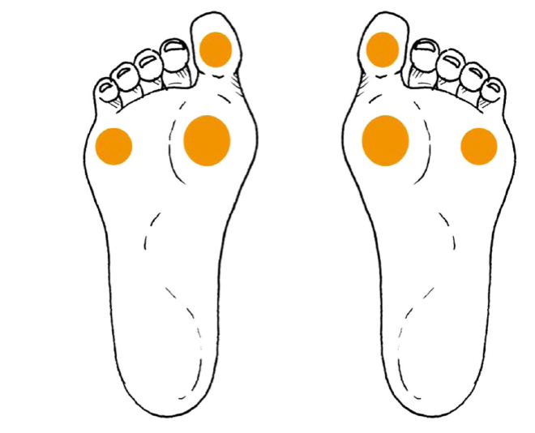
Screening for Protective Sensation Using The 10 gram Monofilament
How to perform the sensory examination:
Conduct in a quiet and relaxed setting.
Begin by applying the monofilament to the hands, elbow or forehead so that patient what to expect.
Ensure that the patient can not see whether or where the monofilament is being applied.
Test the three sites on both feet shown in the figure.
Modified from: Schaper NC, Van Netten JJ, Apelqvist J, Lipsky BA, Bakker K; International Working Group on the Diabetic Foot. Prevention and management of foot problems in diabetes: A Summary Guidance for Daily Practice 2015, based on IWGDF Guidance Documents. Diabetes Metab Res Rev 2016;32 Suppl 1:7-15
Notes:
The 2018 guidelines contain a new appendix outlining use of the 10 gram monofilament based on the International Working Group on the Diabetic Foot guidelines.
Begin by applying the monofilament to the hands, elbow or forehead so that patient what to expect.
Ensure that the patient can not see whether or where the monofilament is being applied.
Test the three sites on both feet shown in the figure.

Slide 30
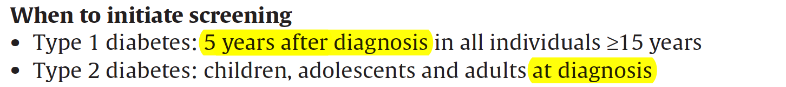
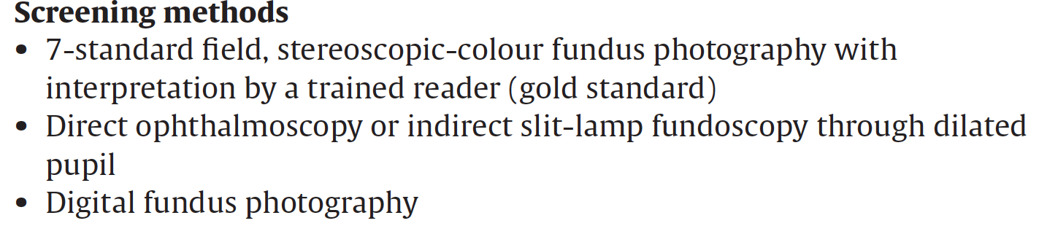
Screening for Retinopathy
2018 Diabetes Canada CPG – Chapter 30. Retinopathy
Notes:
The recommended screening for individuals 15 years or older with type 1 diabetes is screening annually by an experienced vision care professional (such as an optometrist or ophthalmologist) starting 5 years after the onset of diabetes.
In individuals with type 2 diabetes, screening should be performed at the time of diagnosis. The interval for followup assessment should be tailored to the severity of the retinopathy. In those with no or minimal retinopathy, the recommended interval is 1 to 2 years.
Screening should be performed either in person or through interpretation of retinal photographs taken through dilated pupils or undilated pupils with high-resolution ultra-wide field imaging.

Slide 31
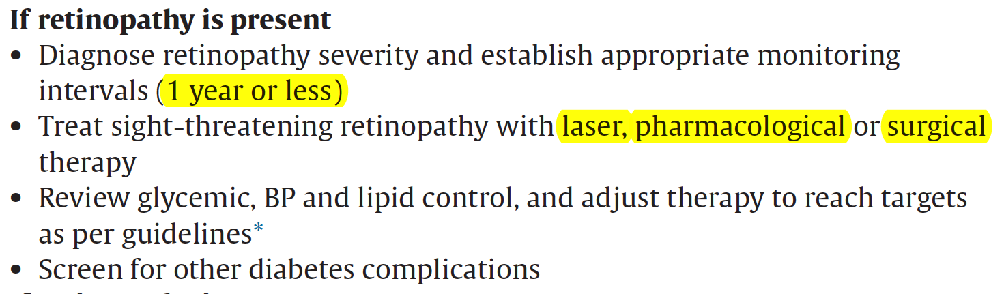
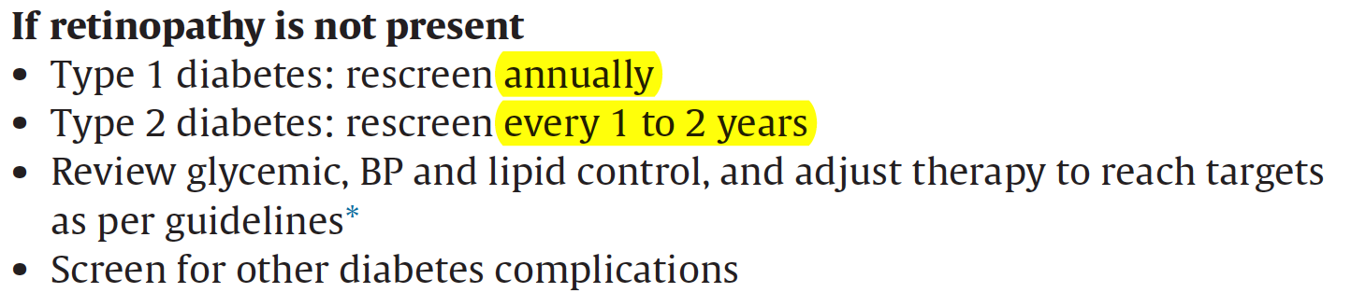
Retinopathy (cont’d)
2018 Diabetes Canada CPG – Chapter 30. Retinopathy
Notes:
Sight-threatening retinopathy should be managed with pharmacological intervention, laser therapy and/or vitrectomy.
It is important to recognize that local intraocular pharmacological therapies have the potential to improve vision and reduce the level of retinopathy.

Slide 32
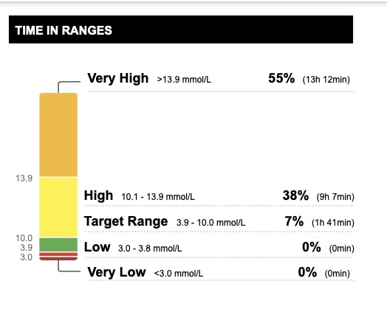

Slide 33
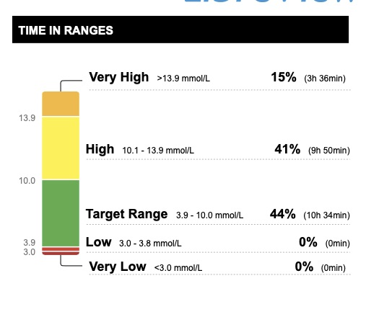

Slide 34
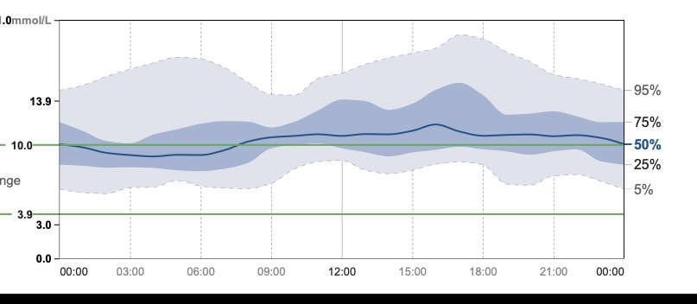

Slide 35
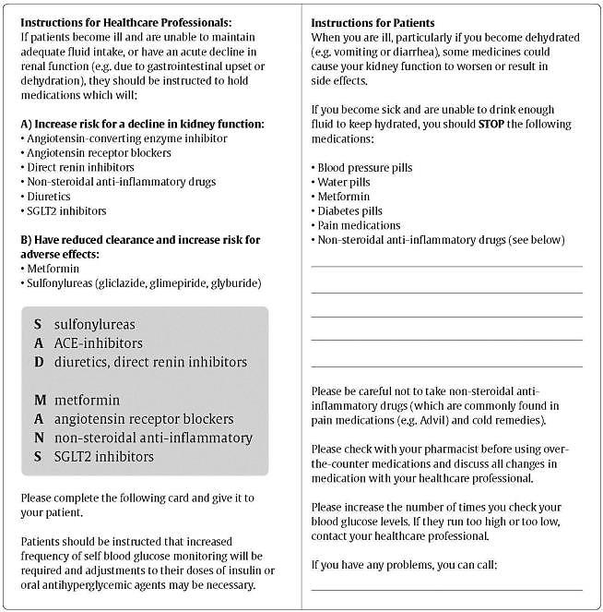
2018 Diabetes Canada CPG – Chapter 29. Chronic Kidney Disease in Diabetes
Counsel all Patients About
Sick Day Medication List
Visit
guidelines.diabetes.ca for patient handout
Notes:
IMPORTANT: Make sure you review the full list of medications on this slide (not just the ones in Lise’s profile).
NEED TO ADDRESS: Considering that SGLT-2i agents are a somewhat recent class, address the concern about SGLT-2i agents when administered in a dehydrated state.
The guidelines include a Sick Day Medication List Appendix outlining this information.
http://guidelines.diabetes.ca/cpg/appendices/appendix8

Slide 40
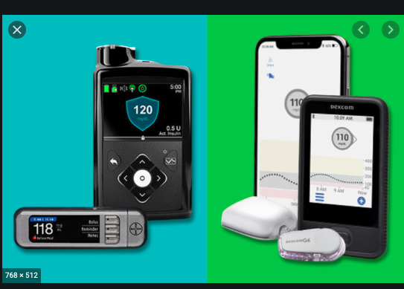
CHANGING
PUMPS

Slide 41
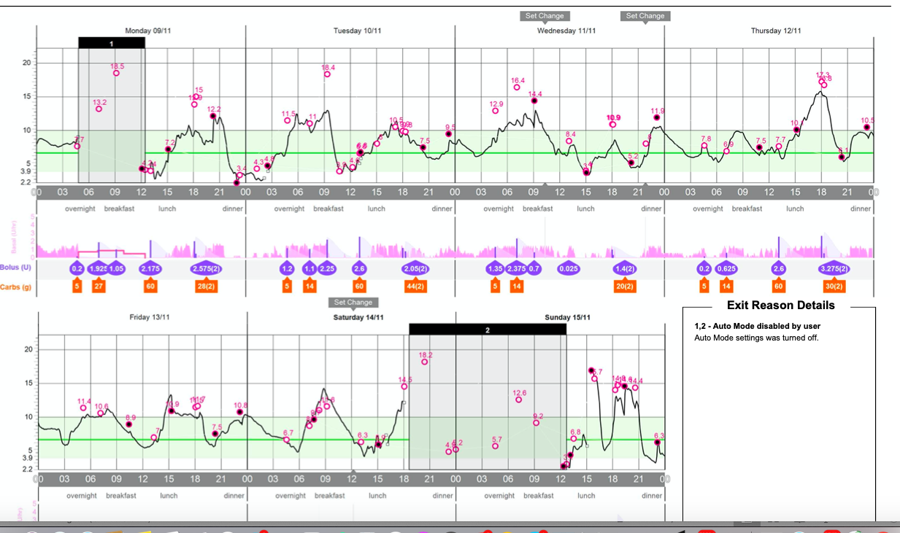
EVERY DAY IS DIFFERENT

Slide 42
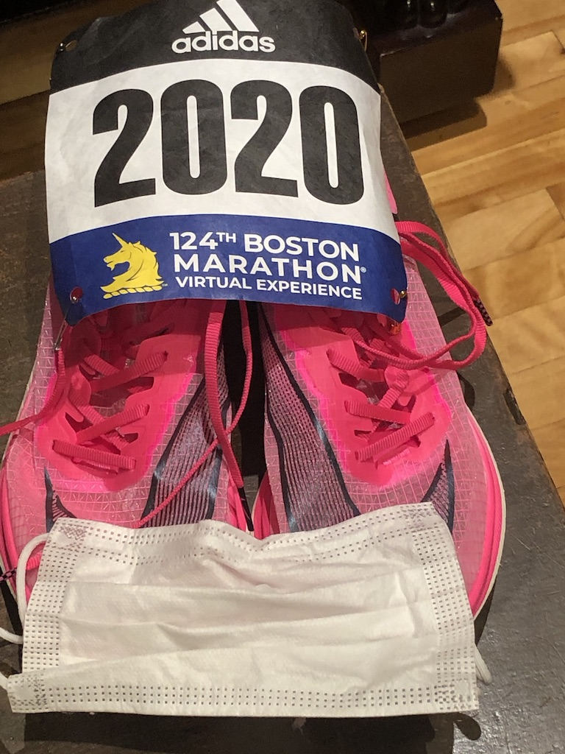

Slide 43

BF; hyperfear
On Medtronic pump
Does not like the sensor
Hyperfear; had lows earlier in her diabetes career; prefers 15???

Slide 44
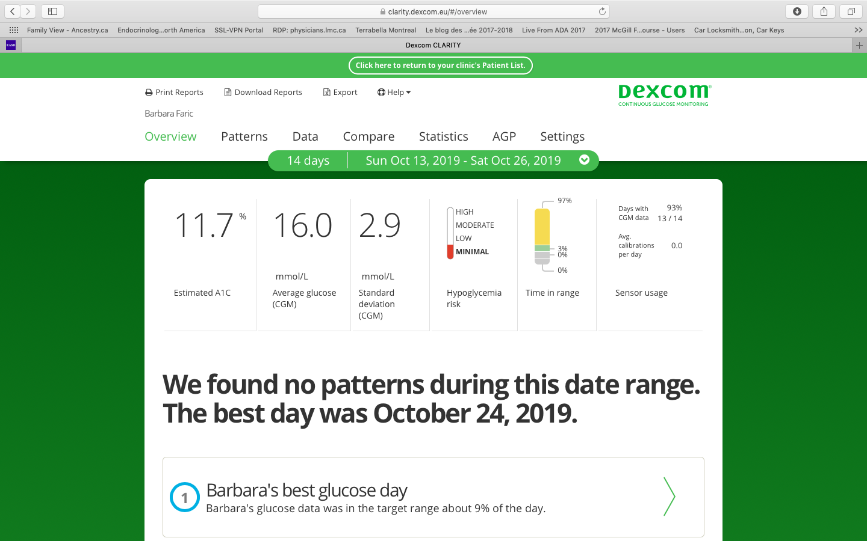

Slide 45
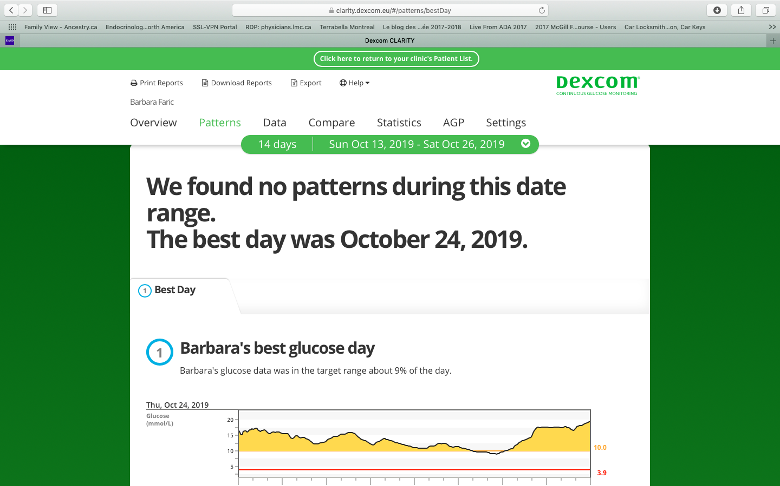

Slide 46
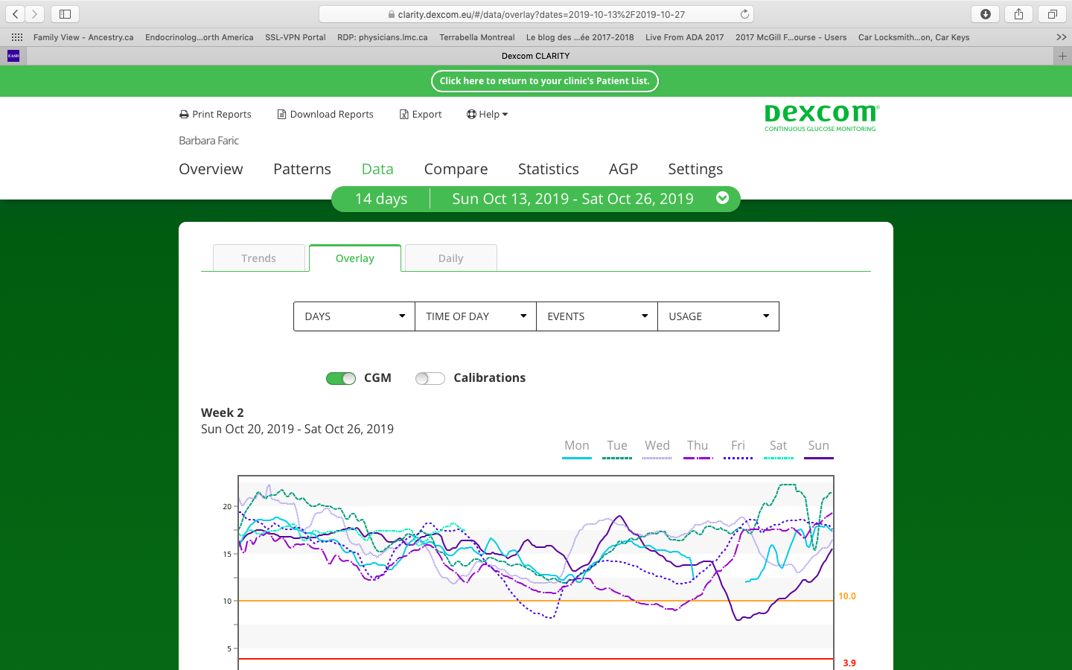

Slide 47
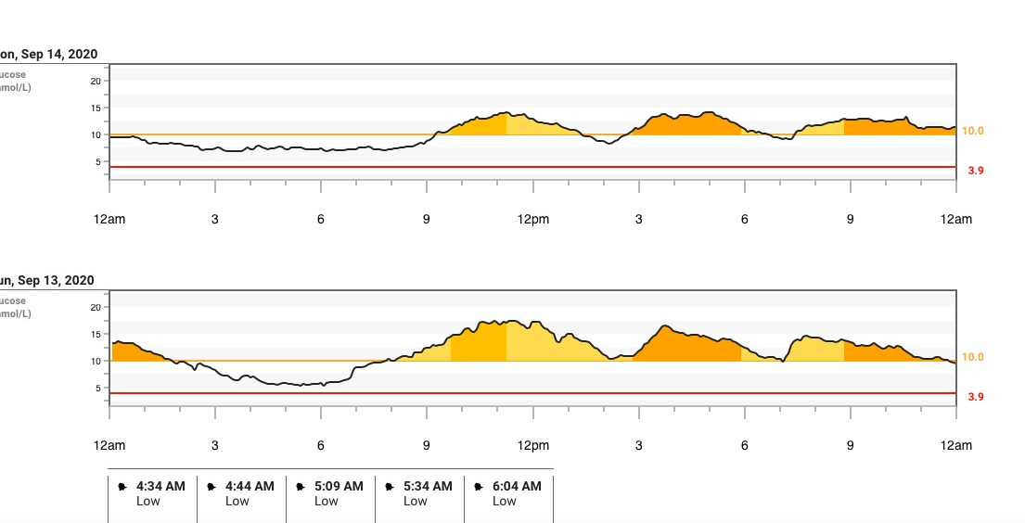

Slide 48
